Slide 1

Streamline your lecture
Notes:
Introduce Project and Website Name, do not give names yet

Slide 2

Meet the Team
Brandon: hosting, database, & back-end PHP
Brandyn: front-end HTML & CSS
Joel: front-end JavaScript
Lauren: React Native app & supporting PHP API
Nick: front-end HTML & CSS
Vanessa: front-end JavaScript & Project Manager
Zach: design mock-ups & React Native app
Notes:
Each Team Member Introduces themselves and their roles

Slide 3
Overview
Asking questions in class can be nerve wracking for students. The fear of being perceived as “dumb” for asking a “stupid” question may hold some students back from asking questions at all.
This app aims to help those students and in doing so improve class participation.
Notes:
Reason why it exists?
To prevent
Shyness
Embarrassment

Slide 4
Features
Anonymous question submission
Surveys generated based on questions
Instructor control panel for adding classes and sessions
Cross-Platform student-facing app
Notes:
Allows for greater
Anonymity
Audience involvement
Versatile (different types of classes)
Inclusive (Android, iOS)

Slide 5
Inspiration
Spring 2018 project: http://cop4331-2.com/
“Anonymous” question submission & survey system
Technologies: LAMP stack, teacher web-app, Android student app
Developers: Matthew Garrison, Warren Atchison, Shane Rhoads, Kobee Raveendran, Nestor Montejo, Julia Berger, and Thomas Anchor
Notes:
Introduce the Old Project

Slide 6
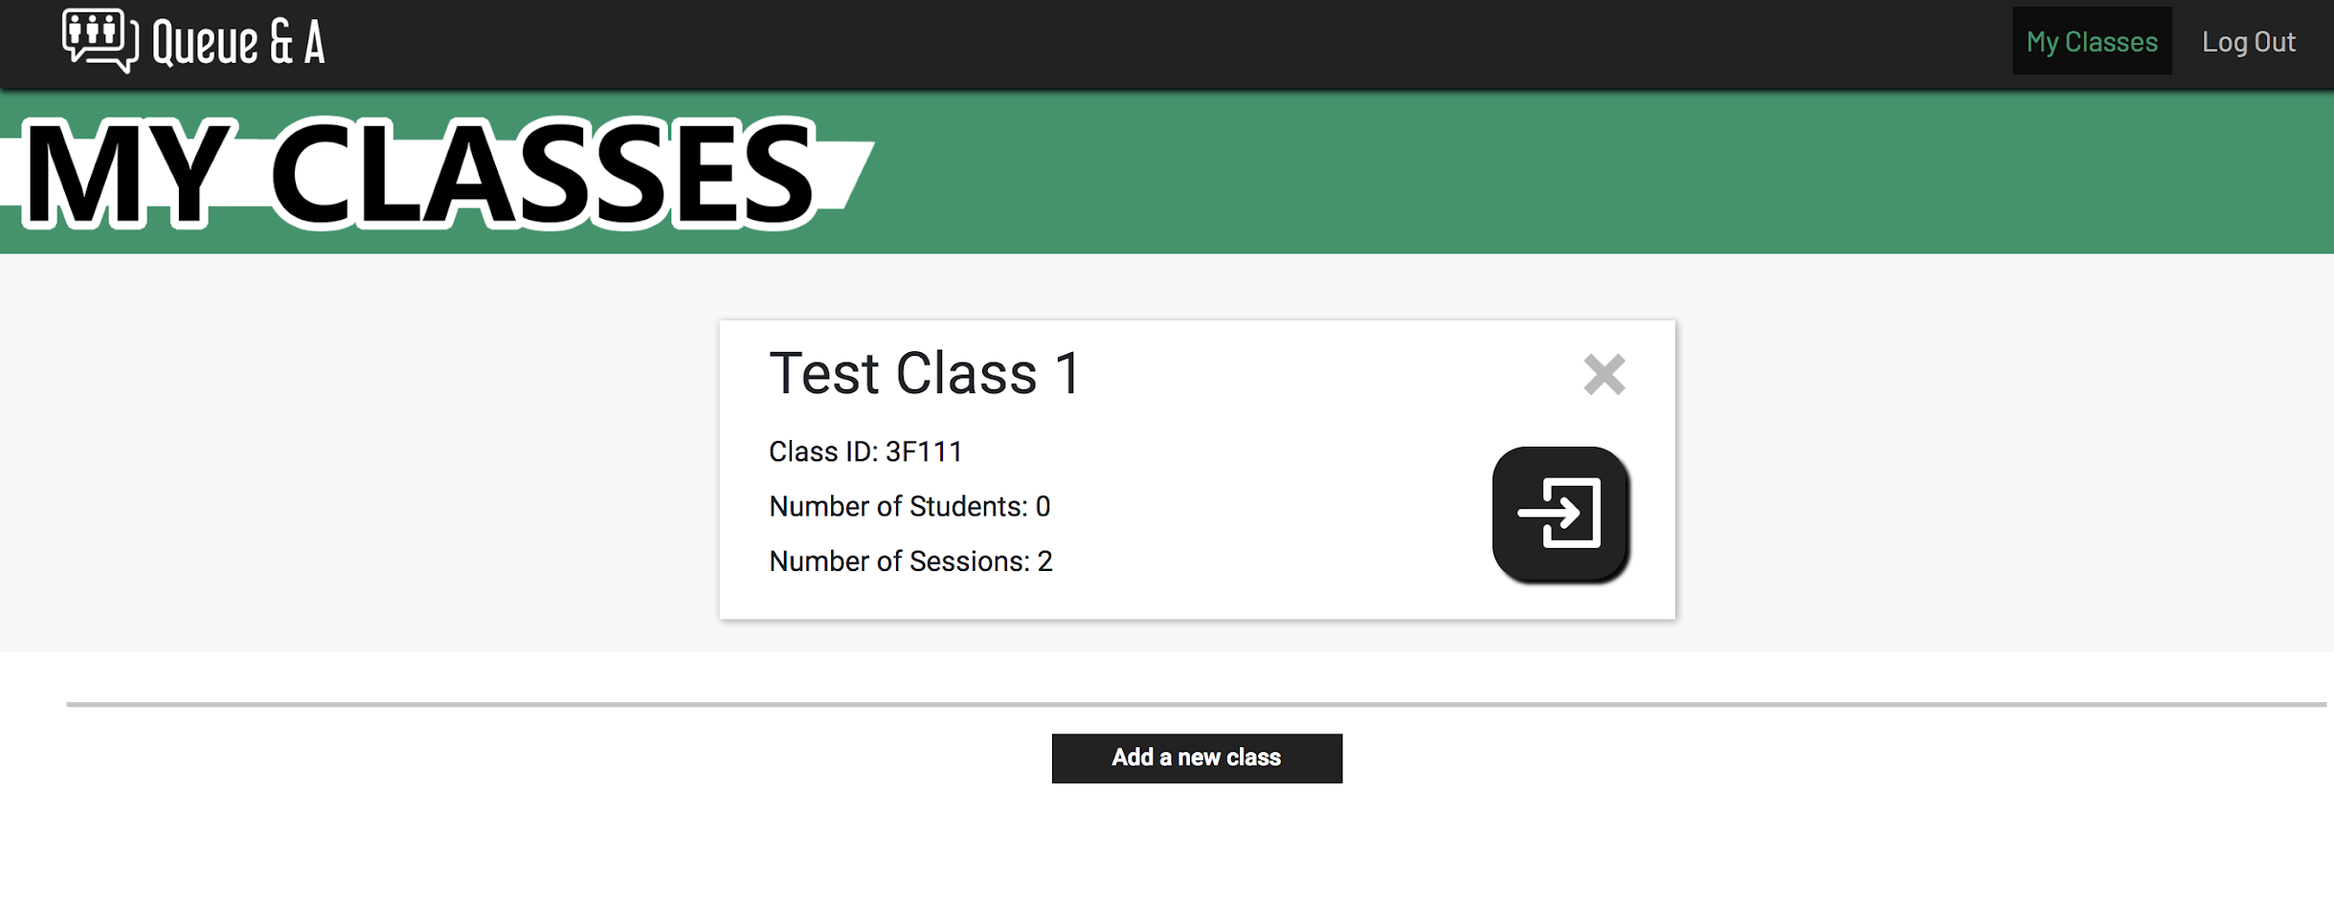
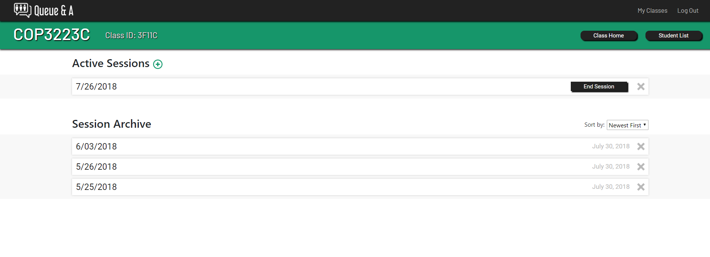
Previous Design
Notes:
Faults in previous that we wanted to correct:
Network connectivity for one
Limited to Android Devices
Lack of web page scaling
Resizing issues

Slide 7
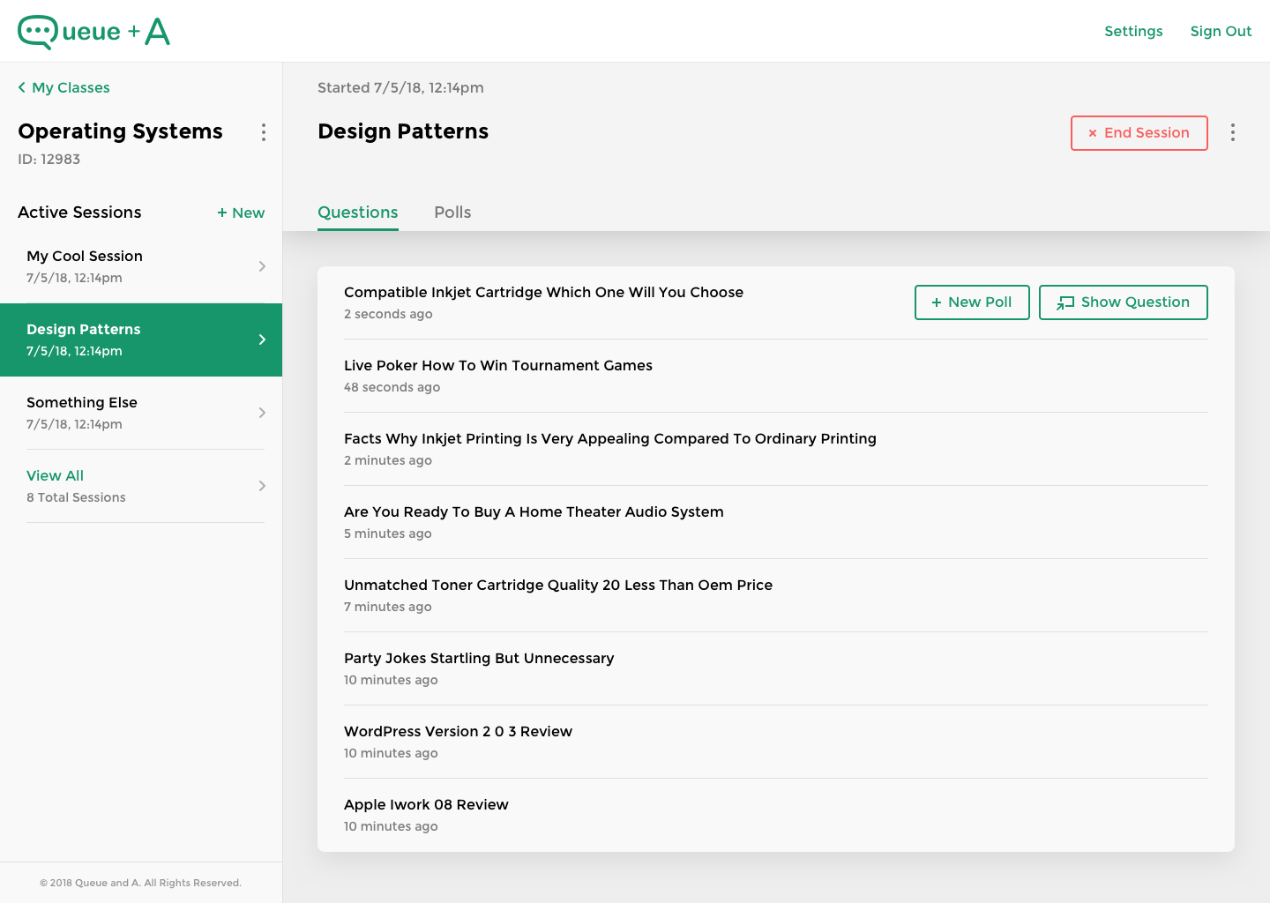
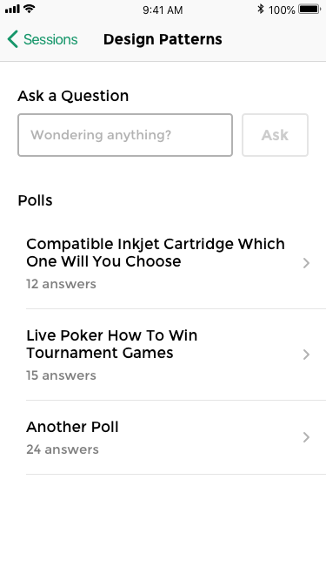
Current Design
Notes:
Will replace with images from live site
.
Talk about sleekness, old one looks dated

Slide 8








Tools/Software/Languages
Notes:
Tools that streamlined and facilitated development
React Native: Mobile App, cross platform
Bootstrap 4 and JS: Website Development, browser compatibility
XAMPP: Local hosting, for testing purposes
Github: File Transfering and Sharing, email doesn’t like JS
PHP: Database communication
Sketch: Front-end Design

Slide 9
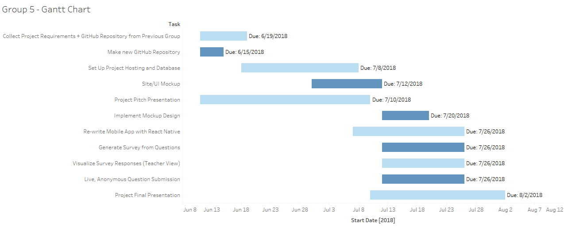
Development Timeline
Notes:
Tools that streamlined and facilitated development
React Native: Mobile App, cross platform
Bootstrap 4 and JS: Website Development, browser compatibility
XAMPP: Local hosting, for testing purposes
Github: File Transfering and Sharing, email doesn’t like JS
PHP: Database communication
Sketch: Front-end Design

Slide 10
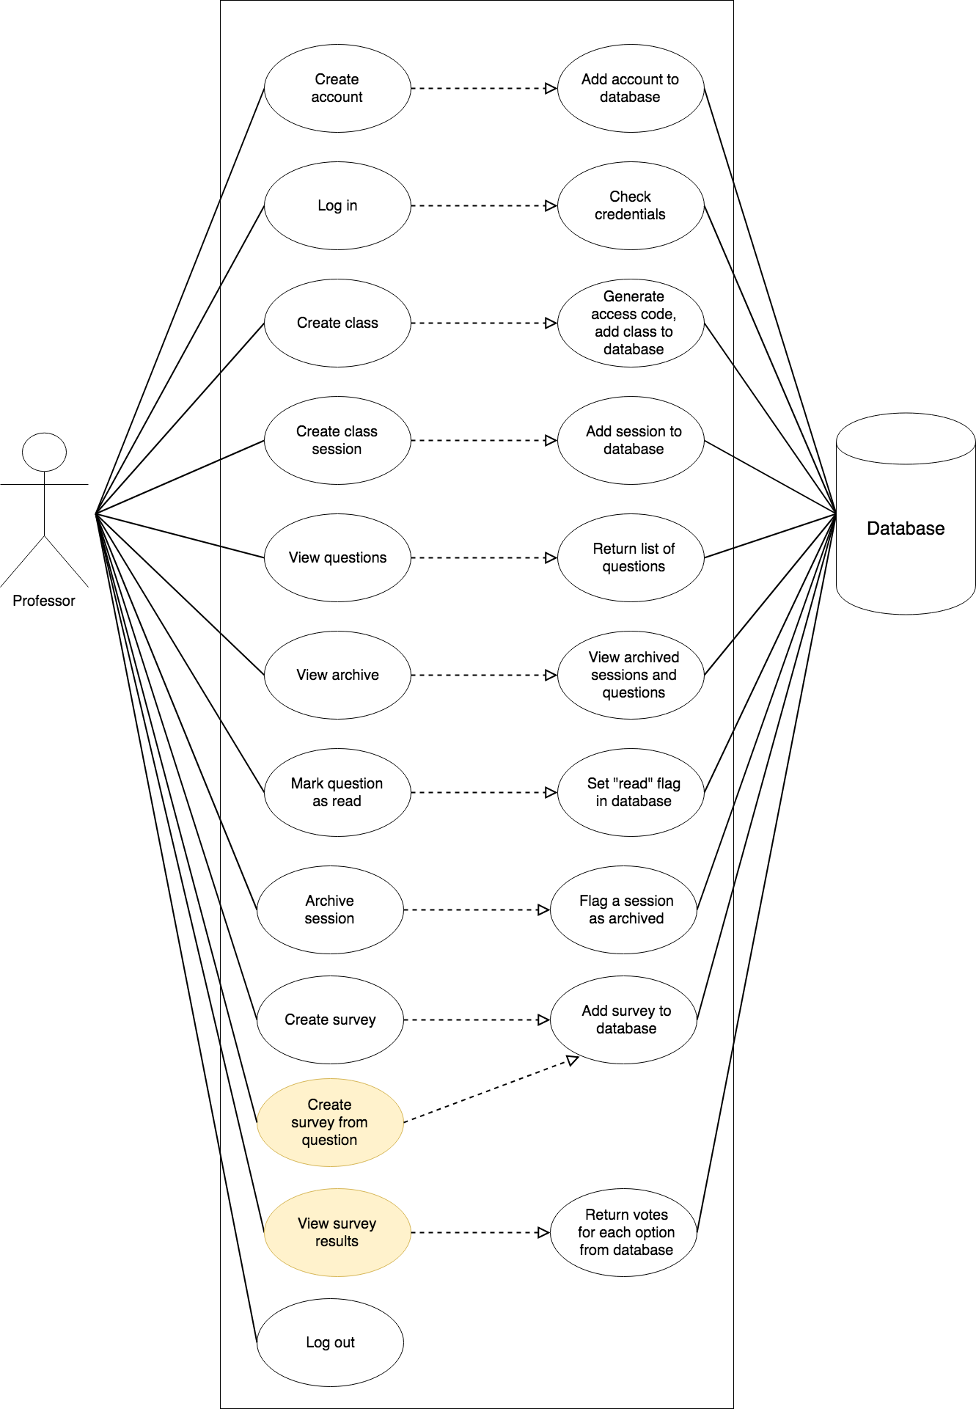
Professor
Use-Case
Diagram
Notes:
Teacher use diagram:
Professor functions include:
Login / Register / Logout
Create / View / Remove Classes and Sessions
Use Qs to Project / Make Poll
Server enables functions and returns approp. data

Slide 11
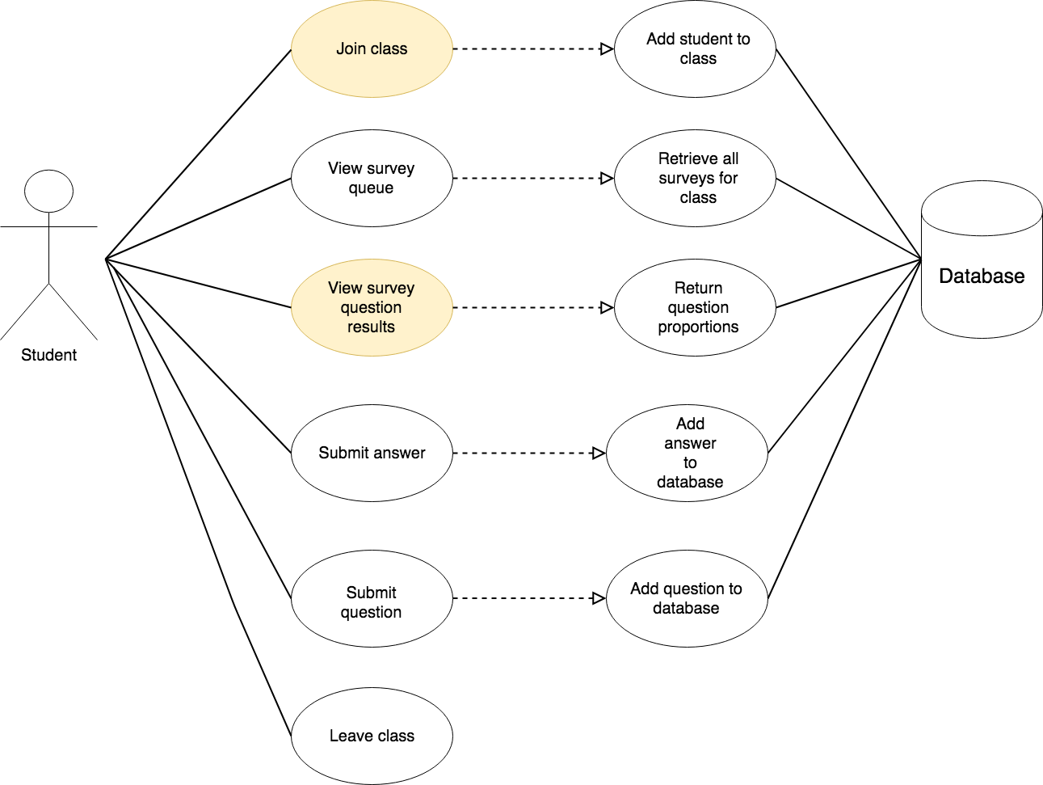
Student Use Case Diagrams
Notes:
Student use diagram:
View Information Created by the Professor
Ex. Enter Class, see all sessions
Input Questions and Poll Answers

Slide 12
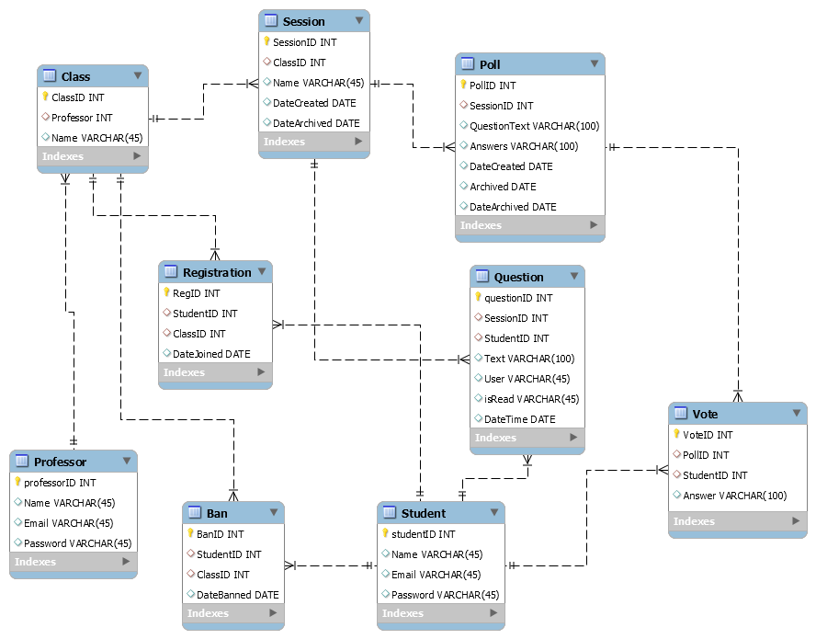
Database ERD
Notes:
ERD shows
relationship between concepts/components
Data variables for each components

Slide 13
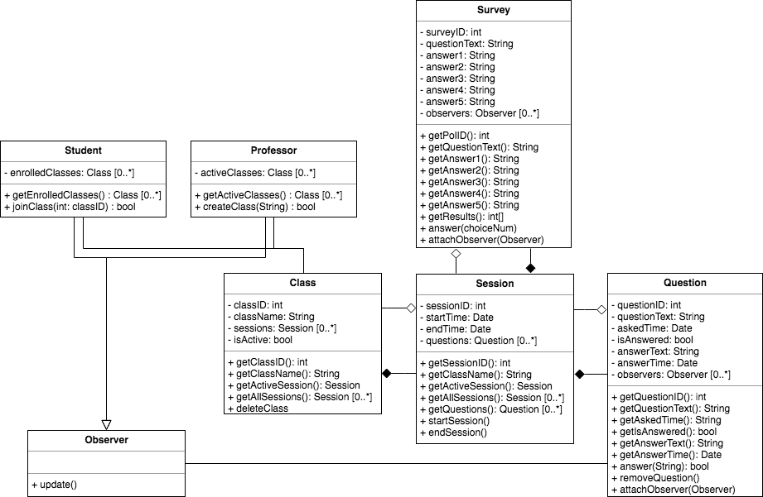
Class UML
Notes:
Professor accounts and Student accounts have separate functions
Both connect the the same Database
Professor:
Create/Delete/Close Classes and Sessions
Display Qs and make polls from Qs
Students:
Create Questions
View/Answer Polls
Server:
Deliver data after request
Create and store classes/sessions/polls
Store Qs and As

Slide 14
Difficulties
React Native learning curve
Encountering pre-existing bugs and unexpected behavior
Making large changes to an existing code base
Dependencies among individual tasks
Falling into anti-patterns: cut-and-paste, lava flow
Notes:
Dependencies:
HTML requires JS
Testing requires Website and App completion
Antipatterns:
Copy and Paste
Lava Flow

Slide 15
Successes
Learned new technologies
Produced functional app- “student-first”
Implemented anonymity
Made major changes to a large, pre-existing code base
Unified design
Notes:
React Native:
Both Android and iOS at the same time
Don’t have to use Android Studios
XAMPP and Hosting:
Allow for quick, live testing
Low Cost
Bootstrap 4:
Seamless design and jQuery support
Modular, adding own CSS or modifying BS4 CSS

Slide 16
Links
GitHub: https://github.com/vgarciadequevedo91/largeProject
Website: http://group5.gearhostpreview.com/
Notes:
React Native:
Both Android and iOS at the same time
Don’t have to use Android Studios
XAMPP and Hosting:
Allow for quick, live testing
Low Cost
Bootstrap 4:
Seamless design and jQuery support
Modular, adding own CSS or modifying BS4 CSS

Slide 17
Demo
Notes:
Exit out of the Slideshow and open the hosted website:
Login Website as Professor, add Class and Session
Login App as Student, as Qs
Website: Select Question and Display
Website: Exit display, create poll from same
Optional:
Allow Download for audience to create account and join demo

Slide 18

Notes:
Pause for Qs, answer Professor first if needed.
Remember to accept questions from back rows
Possible:
Funding
Future

